Slide 1



BOOKS SALES DASHBOARD POWER BI
View in Power BI
Last data refresh:
11/21/2023 8:32:18 PM UTC
Downloaded at:
11/21/2023 8:33:29 PM UTC

Slide 2
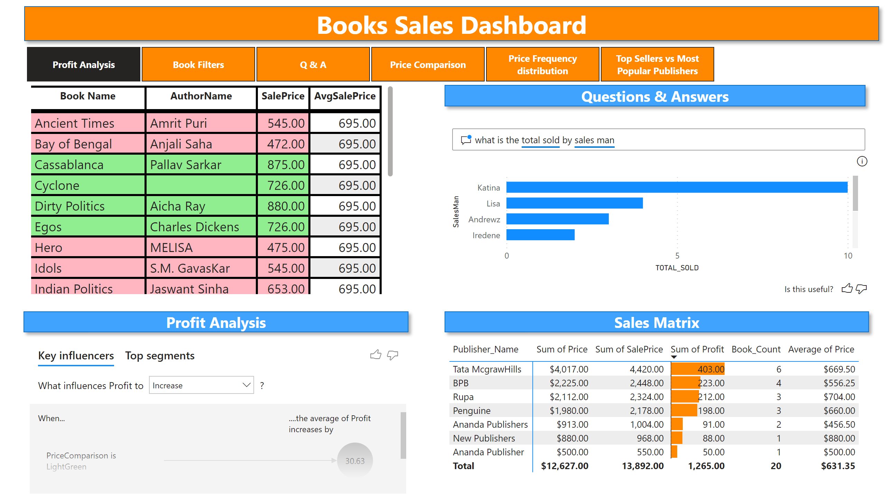
Profit Analysis
Notes:
shape
No alt text provided
shape
No alt text provided
qnaVisual
No alt text provided
keyDriversVisual
No alt text provided
shape
No alt text provided
pivotTable
No alt text provided
tableEx
No alt text provided
shape
No alt text provided
pageNavigator
No alt text provided

Slide 3
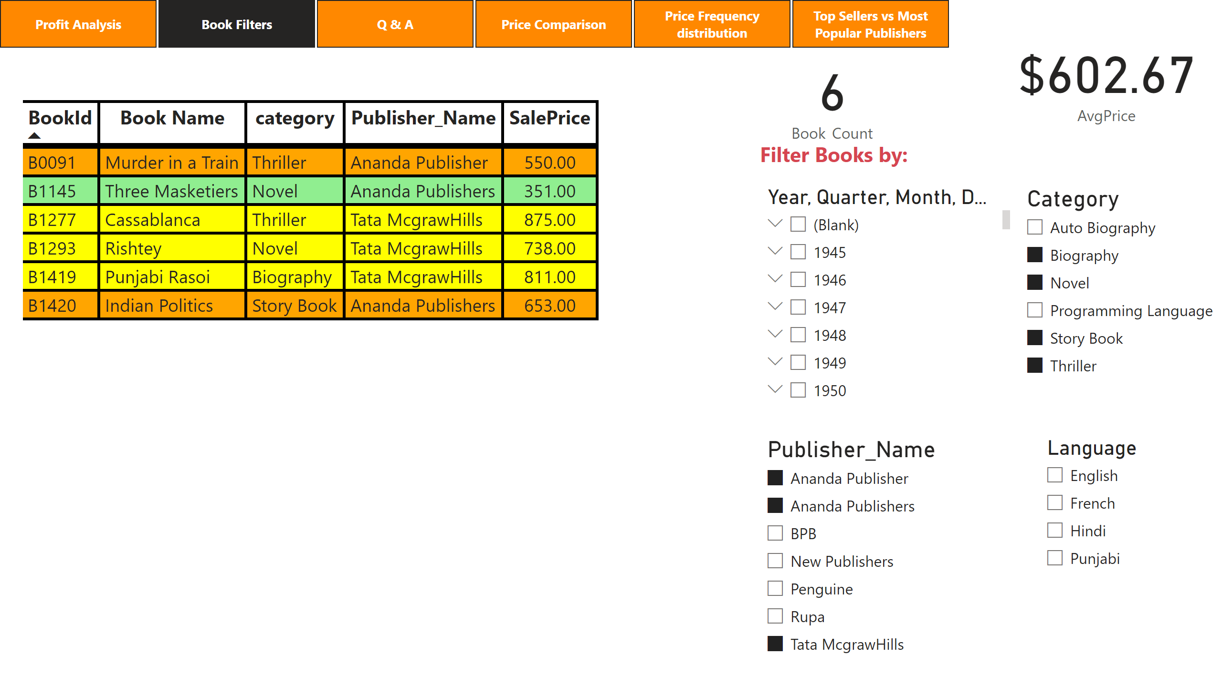
Book Filters
Notes:
tableEx
No alt text provided
textbox
No alt text provided
card
No alt text provided
card
No alt text provided
slicer
No alt text provided
slicer
No alt text provided
slicer
No alt text provided
slicer
No alt text provided
pageNavigator
No alt text provided

Slide 4
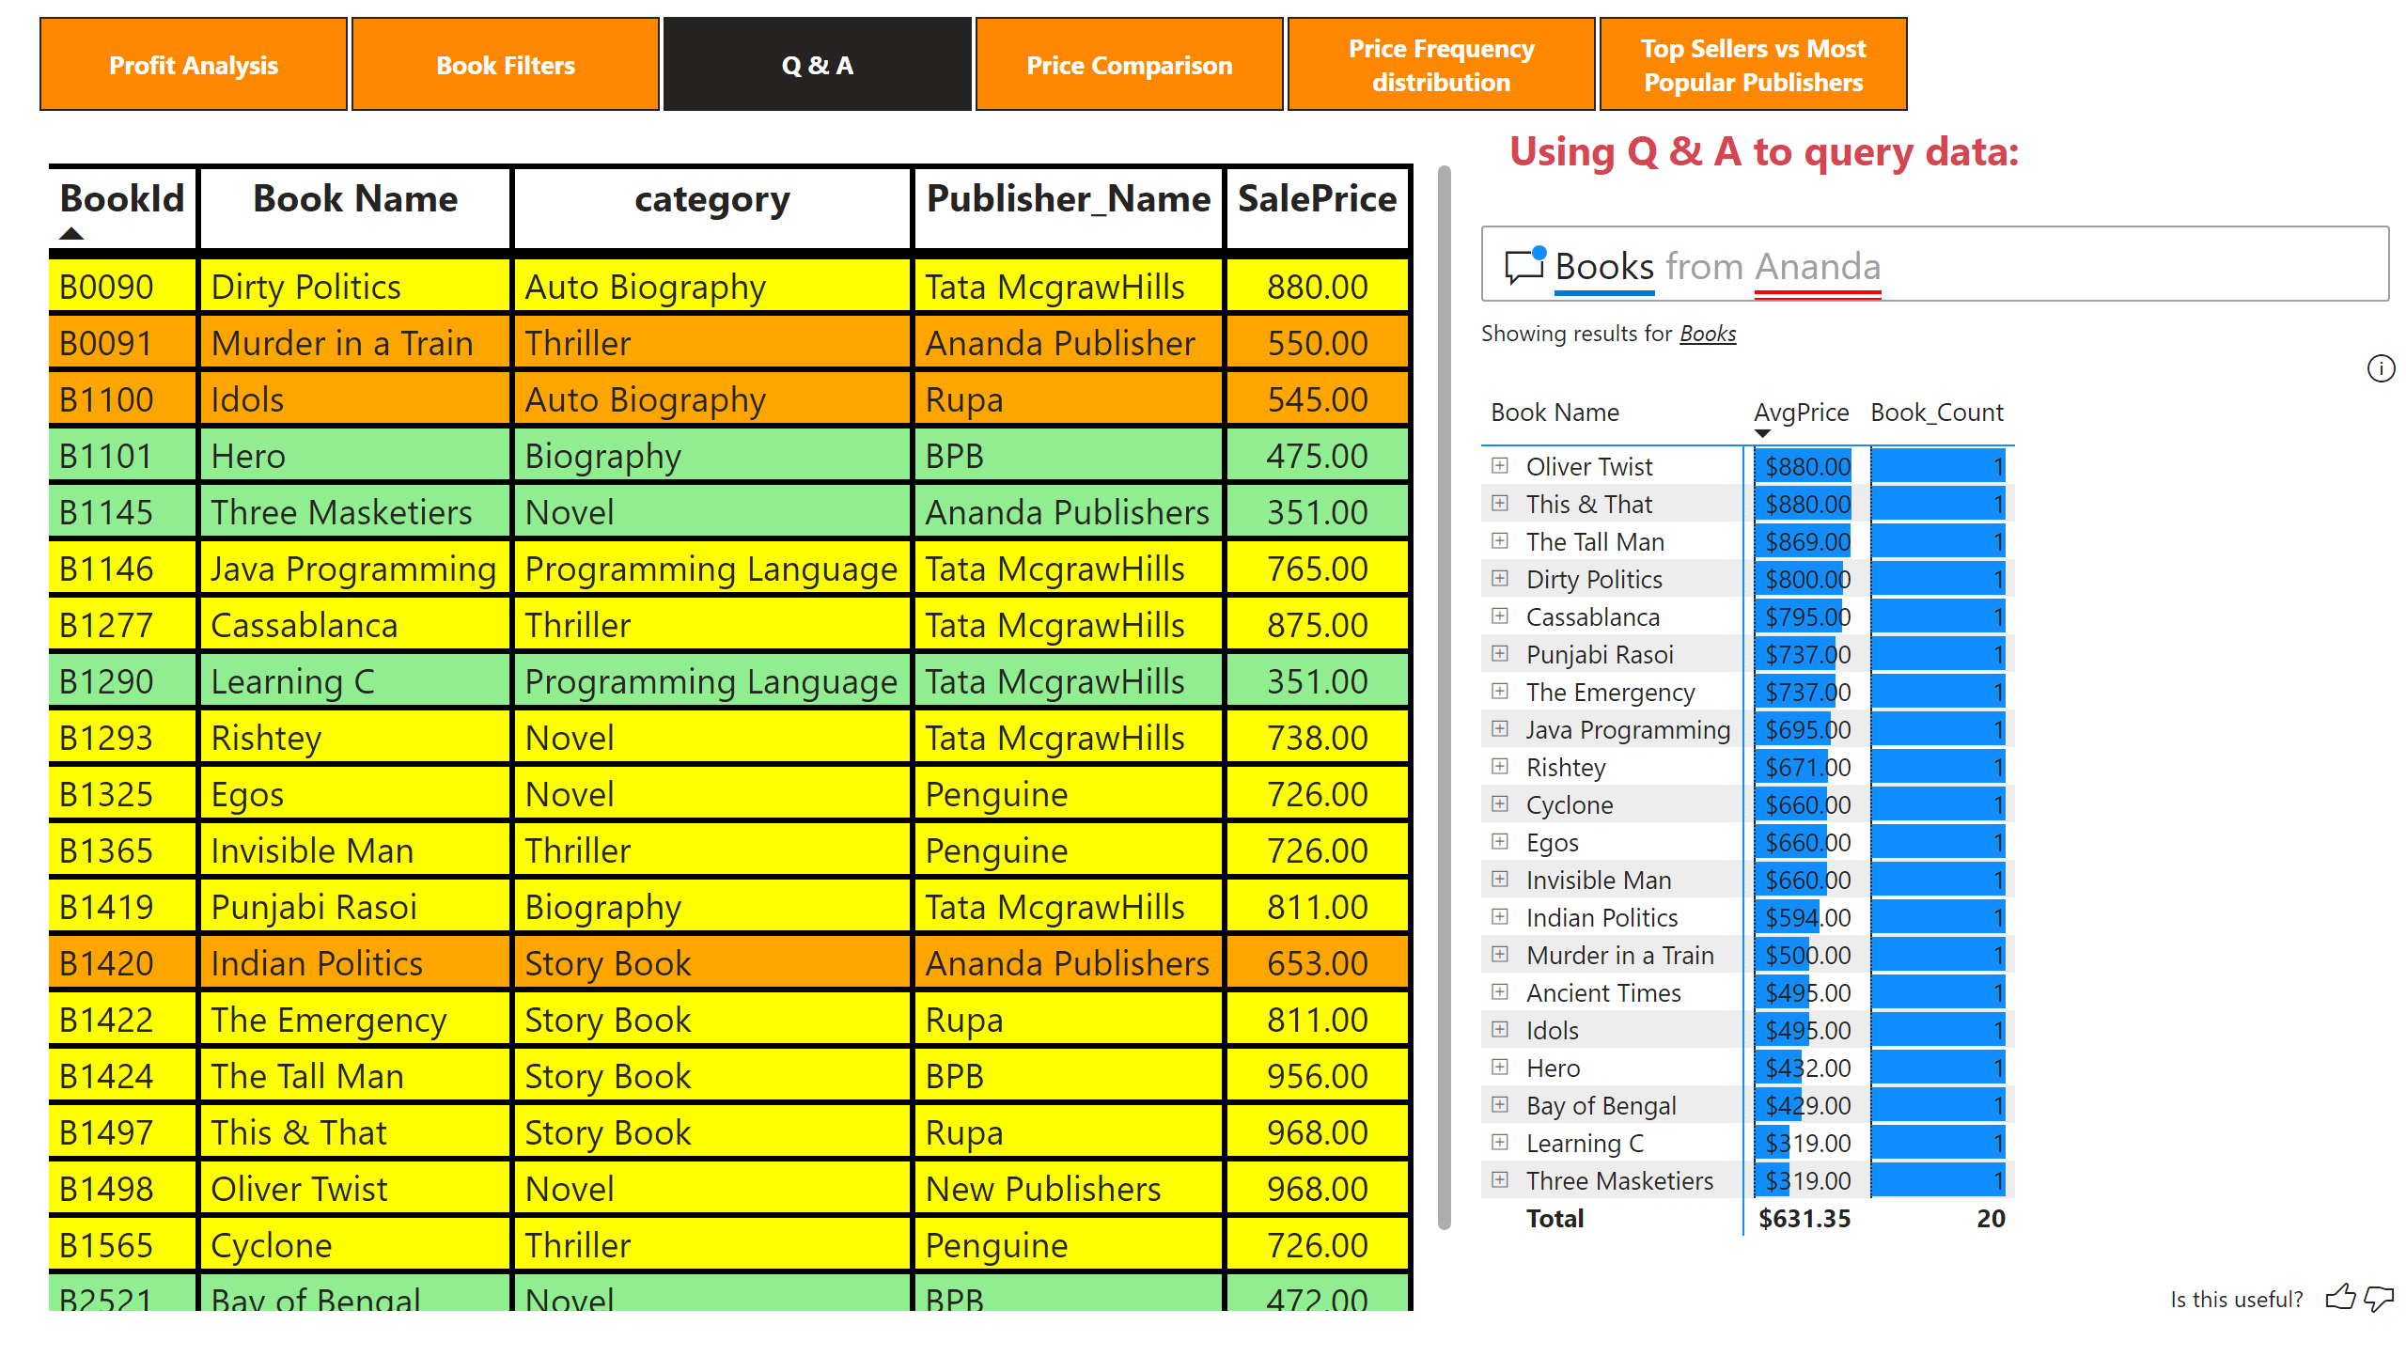
Q & A
Notes:
tableEx
No alt text provided
textbox
No alt text provided
qnaVisual
No alt text provided
pageNavigator
No alt text provided

Slide 5
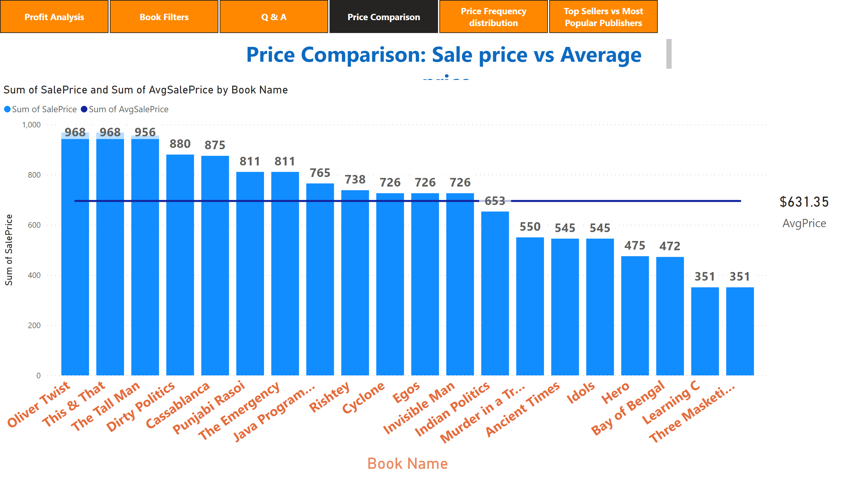
Price Comparison
Notes:
lineStackedColumnComboChart
No alt text provided
card
No alt text provided
textbox
No alt text provided
pageNavigator
No alt text provided

Slide 6
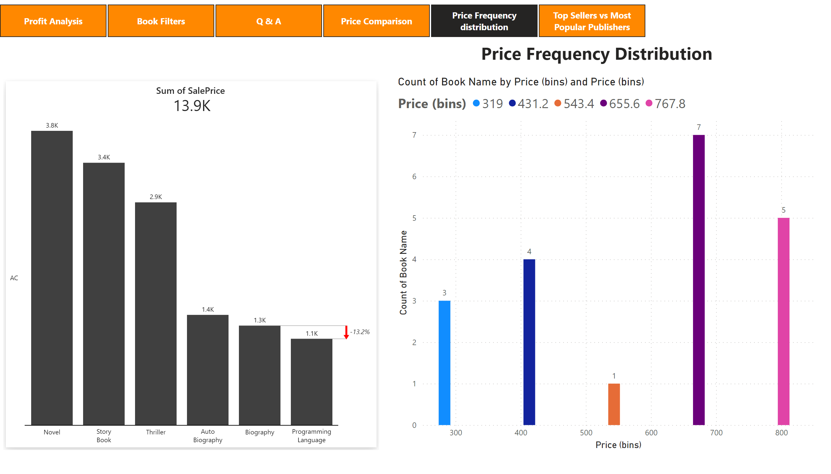
Price Frequency distribution
Notes:
zebraBiCards2C860CFAA9944091B75F0DBD117F20FA
No alt text provided
clusteredColumnChart
No alt text provided
textbox
No alt text provided
pageNavigator
No alt text provided

Slide 7
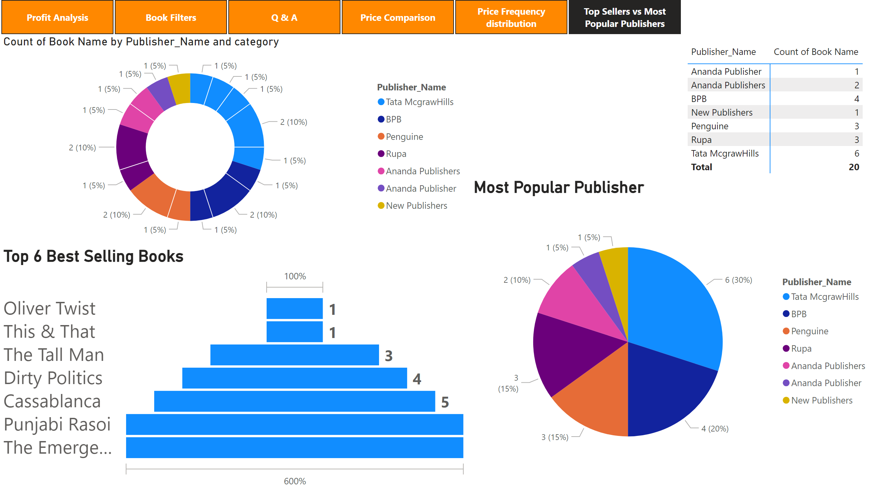
Top Sellers vs Most Popular Publishers
Notes:
pivotTable
No alt text provided
Most Popular Publisher
No alt text provided
donutChart
No alt text provided
Top 6 Best Selling Books
No alt text provided
pageNavigator
No alt text provided

Slide 8
Power BI Quick Insights Feature
There are many more insights apart from the ones mentioned below.

Slide 9
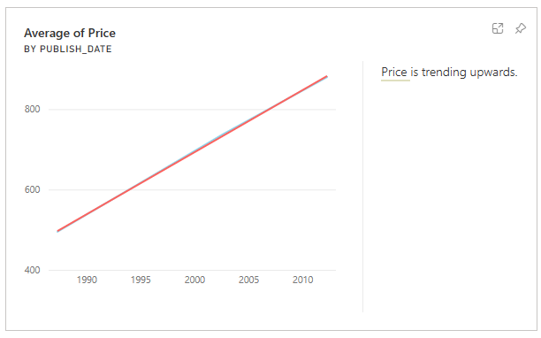
Top Sellers vs Most Popular Publishers
Notes:
pivotTable
No alt text provided
Most Popular Publisher
No alt text provided
donutChart
No alt text provided
Top 6 Best Selling Books
No alt text provided
pageNavigator
No alt text provided

Slide 10
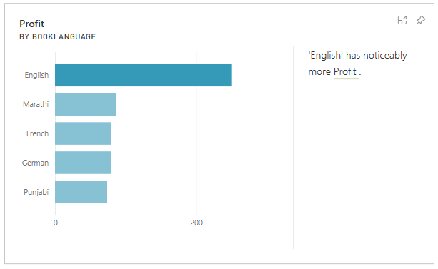
Top Sellers vs Most Popular Publishers
Notes:
pivotTable
No alt text provided
Most Popular Publisher
No alt text provided
donutChart
No alt text provided
Top 6 Best Selling Books
No alt text provided
pageNavigator
No alt text provided

Slide 11
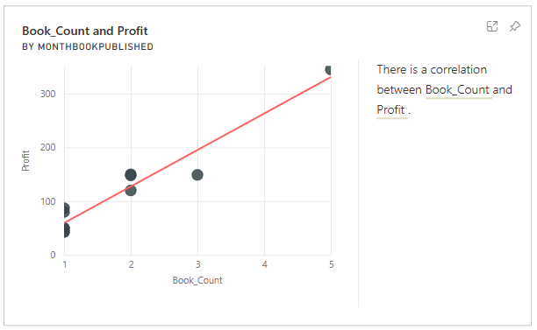
Top Sellers vs Most Popular Publishers
Notes:
pivotTable
No alt text provided
Most Popular Publisher
No alt text provided
donutChart
No alt text provided
Top 6 Best Selling Books
No alt text provided
pageNavigator
No alt text provided

Slide 12
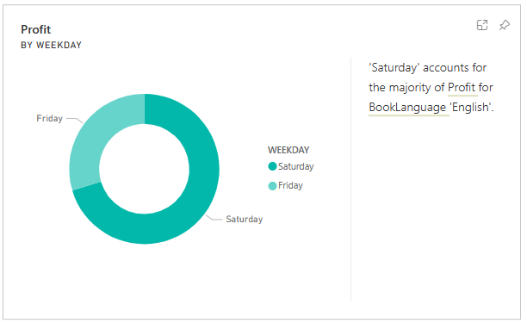
Top Sellers vs Most Popular Publishers
Notes:
pivotTable
No alt text provided
Most Popular Publisher
No alt text provided
donutChart
No alt text provided
Top 6 Best Selling Books
No alt text provided
pageNavigator
No alt text provided

Slide 13
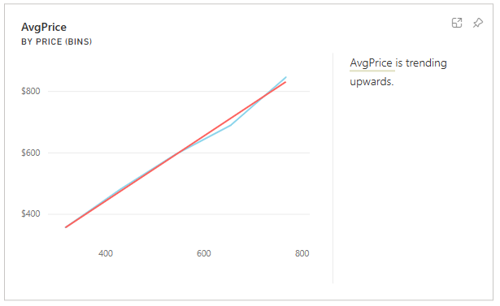
Top Sellers vs Most Popular Publishers
Notes:
pivotTable
No alt text provided
Most Popular Publisher
No alt text provided
donutChart
No alt text provided
Top 6 Best Selling Books
No alt text provided
pageNavigator
No alt text provided

Slide 14
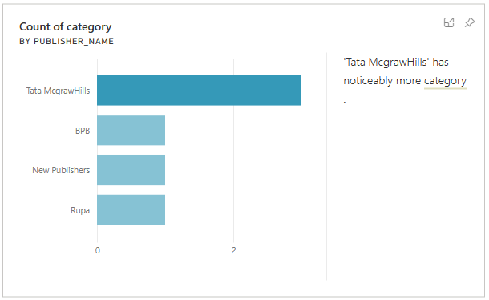
Top Sellers vs Most Popular Publishers
Notes:
pivotTable
No alt text provided
Most Popular Publisher
No alt text provided
donutChart
No alt text provided
Top 6 Best Selling Books
No alt text provided
pageNavigator
No alt text provided

Slide 15
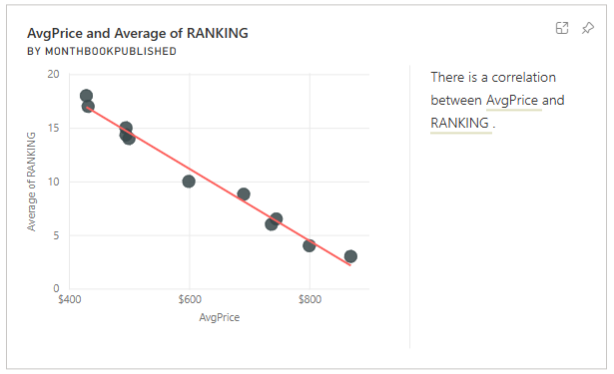
Top Sellers vs Most Popular Publishers
Notes:
pivotTable
No alt text provided
Most Popular Publisher
No alt text provided
donutChart
No alt text provided
Top 6 Best Selling Books
No alt text provided
pageNavigator
No alt text provided

Slide 16
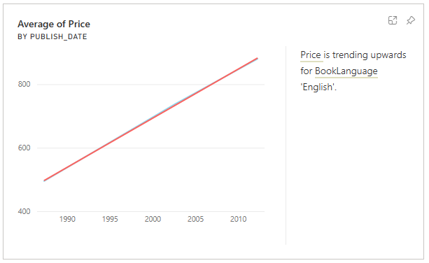
Top Sellers vs Most Popular Publishers
Notes:
pivotTable
No alt text provided
Most Popular Publisher
No alt text provided
donutChart
No alt text provided
Top 6 Best Selling Books
No alt text provided
pageNavigator
No alt text provided

Slide 17
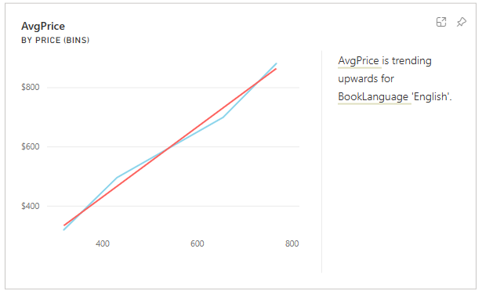
Top Sellers vs Most Popular Publishers
Notes:
pivotTable
No alt text provided
Most Popular Publisher
No alt text provided
donutChart
No alt text provided
Top 6 Best Selling Books
No alt text provided
pageNavigator
No alt text provided

Slide 18
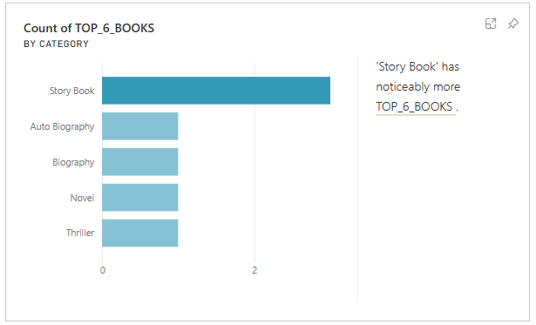
Top Sellers vs Most Popular Publishers
Notes:
pivotTable
No alt text provided
Most Popular Publisher
No alt text provided
donutChart
No alt text provided
Top 6 Best Selling Books
No alt text provided
pageNavigator
No alt text provided

